Slide 1




CS - 744
AUTOMATIC PLANT WATERING SYSTEM
Name : Kinshuk Sharely
Roll No : 20DCS024

Slide 2
INDEX
INTRODUCTION
TINKERCAD
COMPONENTS USED
IMPLEMENTATION
HARDWARE SETUP
SIMULATION
REFERENCES

Slide 3
INTRODUCTION
Nowadays due to the busy schedules, people often forget to water their plants. So this project uses smart technology to automatically water plants, ensuring they stay healthy and happy. With just a few simple steps, this system can be set up which will keep the plants hydrated without the hassle of manual watering. Let's dive in and discover how our project can make plant care easier !

Slide 4
TINKERCAD
Tinkercad Simulator is an online platform that provides a virtual environment for simulating and testing Arduino and Raspberry Pi projects. It allows users to design, code, and simulate electronic circuits and microcontroller-based projects without the need for physical hardware

Slide 5
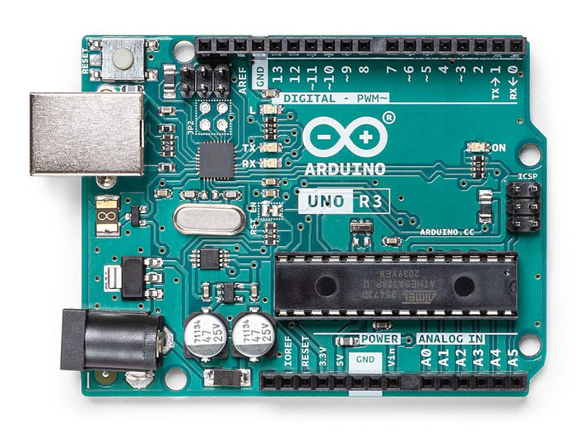
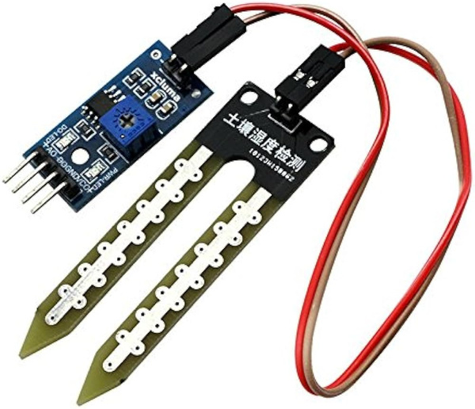
COMPONENTS USED
Arduino UNO R3
Humidity Sensor

Slide 6
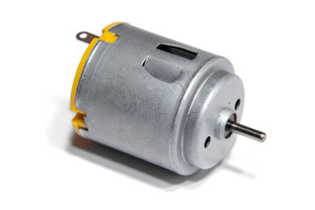
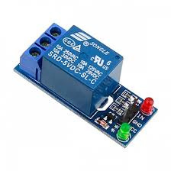
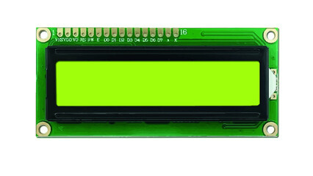
COMPONENTS USED
DC motor
LCD 16X2
RELAY

Slide 7

IMPLEMENTATION
Sensor Monitoring
The project utilizes humidity sensor to detect when the soil have enough moisture levels to support adequate plant health and growth.
It typically contains a material that changes its electrical conductivity in response to changes in humidity levels.
CS - 744
2. Hardware Setup
The sensor is connected to the microcontroller through an analog pin (A0)
The LCD is also connected to the microcontroller through various Digital Pins
The DC motor is connected to a relay which is used to turn it ON/OFF depending on the signal that is provided by the microcontroller to it.

Slide 8
IMPLEMENTATION
3. Data Processing
The microcontroller continuously monitors the sensor’s readings.
The readings are directly printed on the LCD.
If the humidity value if lower than 40% then signal will be sent to the relay which will ultimately turn on the high voltage DC Motor.
CS - 744
4. System Activation
Upon detection of Lower Humidity levels the DC Motor starts which acts as a water pump.
As the moisture levels in the soil reach the threshold levels the microcontroller sends the signal to relay and the DC Motor stops.
All this can also be seen in the LCD Display.

Slide 9

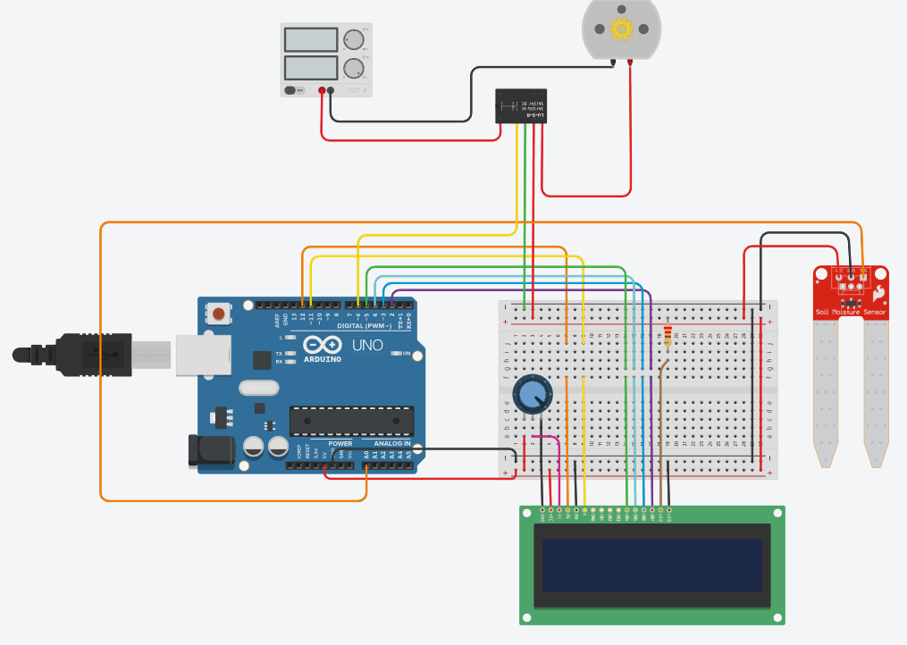
HARDWARE SETUP
DC MOTOR
POWER
SUPPLY
RELAY
HUMIDITY
SENSOR
UNO R3
LCD 16X2
CS - 744

Slide 10
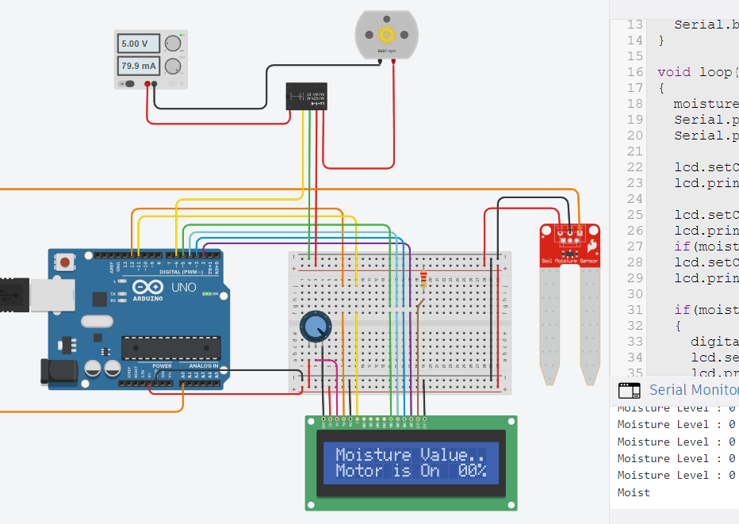
SIMULATION

Slide 11
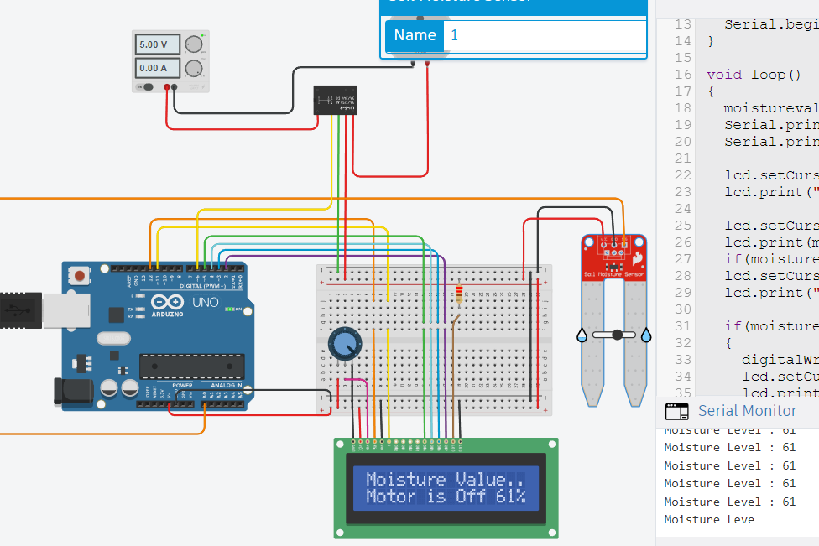
SIMULATION

Slide 12
REFERENCES
https://luckyarduino.blogspot.com/2022/05/
https://www.youtube.com/watch?v=ZxQf2L-UWEA
https://components.omron.com/sg-en/products/basicknowledge/relays/basics

Slide 13
THANK YOU

